Slide 1

Linear and Multilinear Algebra
José Gerardo Fonteles lopes - 407341
Fortaleza, November2017

Slide 2
Outline
In this presentation, it will be presented the following implementation:
Kronecker Product;
Khatri-Rao Product;
Hadamard Product;
Least-Squares Khatri-Rao Factorization Algorithm;
Least-Squares Kronecker Factorization Algorithm;

Slide 3
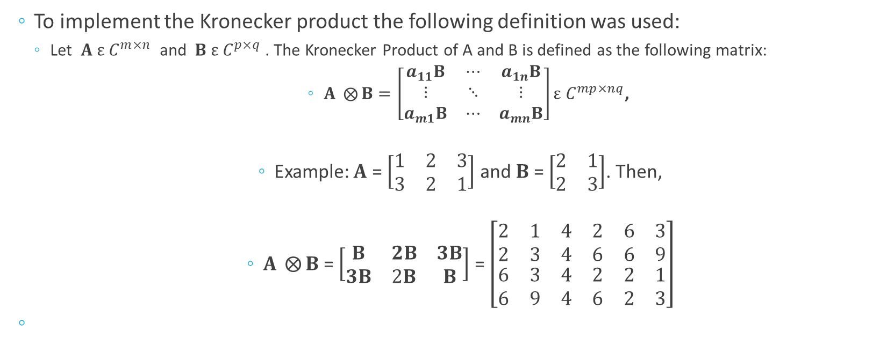
Kronecker Product
To implement the Kronecker product the following definition was used:
Let $A ε C^{m×n}$ and $B ε C^{p×q}$. The Kronecker Product of A and B is defined as the following matrix:
$A ⨂{B}=\left[\begin{matrix}a_{11}B & ⋯ & a_{1n}B \\ ⋮ & ⋱ & ⋮ \\ a_{m1}B & ⋯ & a_{mn}B\end{matrix}\right]ε C^{mp×nq}$,
Example: $A$ = $\left[\begin{matrix}1 & 2 & 3 \\ 3 & 2 & 1\end{matrix}\right]$ and $B$ = $\left[\begin{matrix}2 & 1 \\ 2 & 3\end{matrix}\right]$. Then,
$A ⨂{B}$ = $\left[\begin{matrix}B & 2B & 3B \\ 3B & 2B & B\end{matrix}\right]$ = $\left[\begin{matrix}\begin{matrix}2 & 1 \\ 2 & 3\end{matrix} & \begin{matrix}4 & 2 \\ 4 & 6\end{matrix} & \begin{matrix}6 & 3 \\ 6 & 9\end{matrix} \\ \begin{matrix}6 & 3 \\ 6 & 9\end{matrix} & \begin{matrix}4 & 2 \\ 4 & 6\end{matrix} & \begin{matrix}2 & 1 \\ 2 & 3\end{matrix}\end{matrix}\right]$

Slide 4
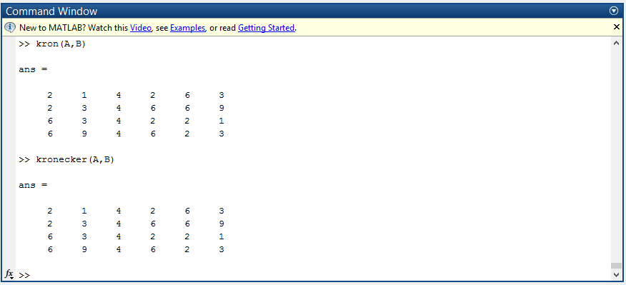
Kronecker Product Simulation
Figure 1: Matlab kron and the implemented kronecker.

Slide 5
Kronecker Product
In Matlab...

Slide 6
Least-Squares Kronecker Factorization Algorithm
In Matlab...

Slide 7
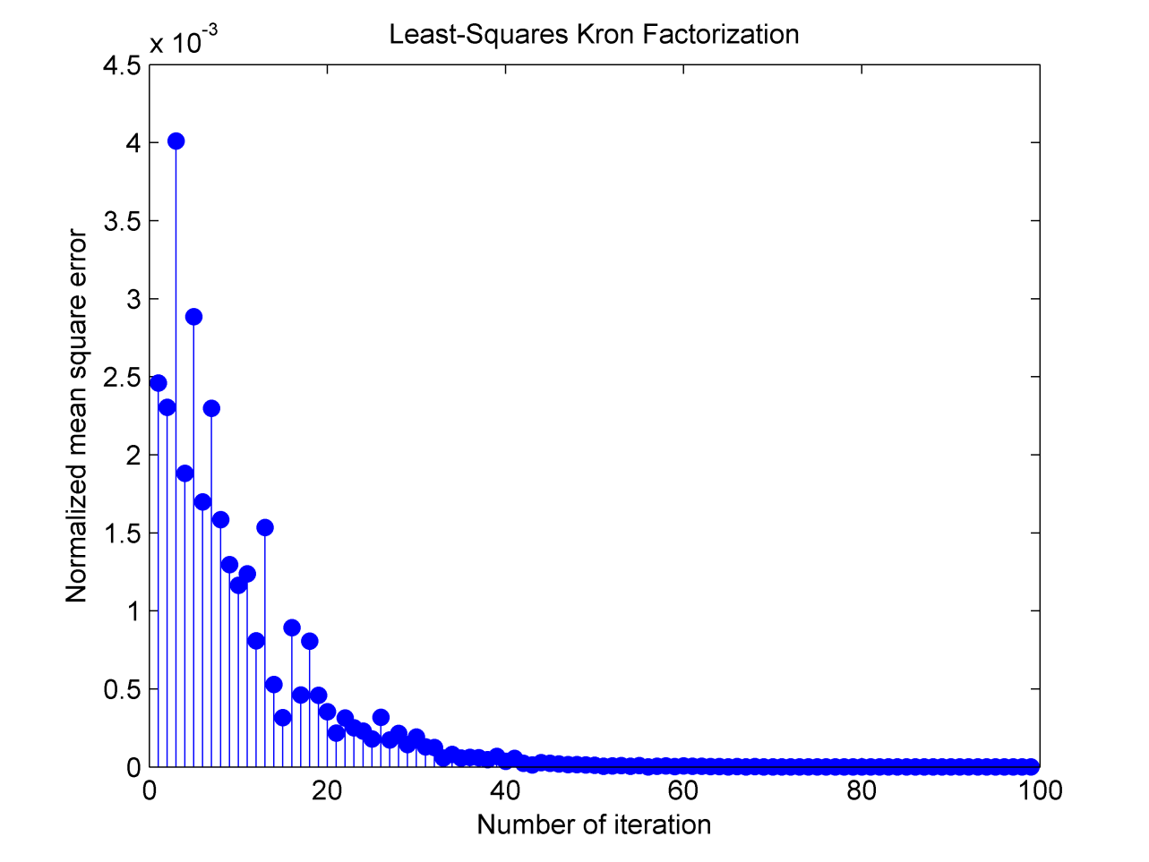
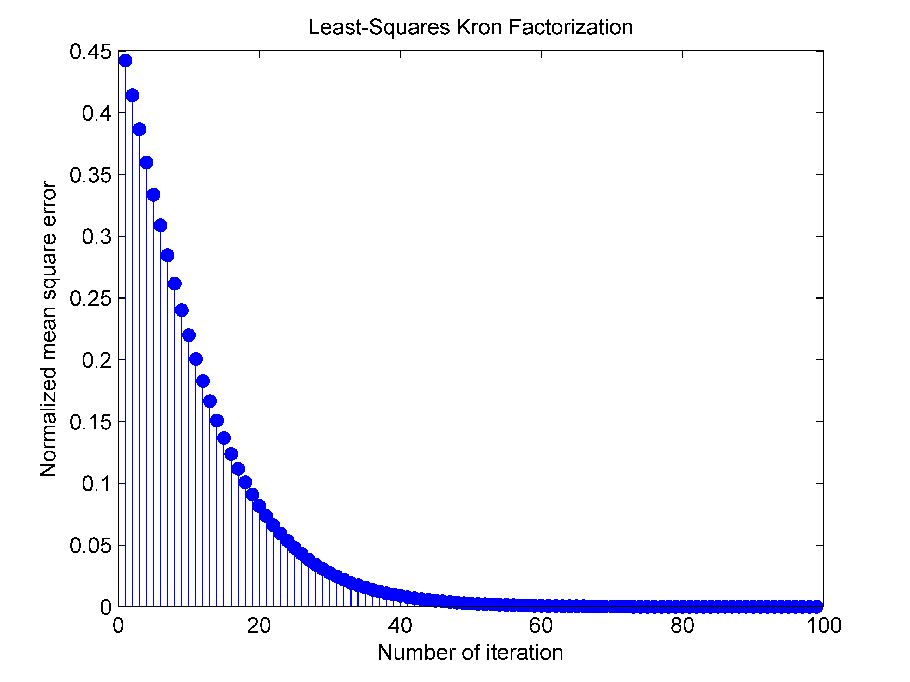
Least-Squares Kronecker Factorization Simulation
Figure 2: Least–Squares for the first example
Figure 3: Least–Squares for two Hadamard matrices

Slide 8
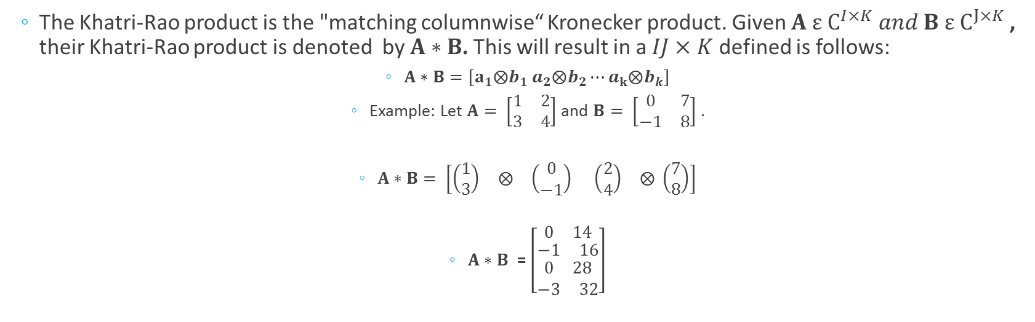
Khatri-Rao Product
The Khatri-Rao product is the "matching columnwise“ Kronecker product. Given $A ε C^{I×K} and B ε C^{J×K}$, their Khatri-Rao product is denoted by $A∗B$. This will result in a $IJ×K$defined is follows:
$A∗B=[a_{1}⨂b_{1} a_{2}⨂b_{2}⋯a_{k}⨂b_{k}]$
Example: Let $A= \left[\begin{matrix}1 & 2 \\ 3 & 4\end{matrix}\right]$ and $B= \left[\begin{matrix}0 & 7 \\ −1 & 8\end{matrix}\right]$ .
$A∗B= \left[\begin{matrix}\left(\begin{matrix}1 \\ 3\end{matrix}\right) & \begin{matrix}⨂ & \left(\begin{matrix}0 \\ −1\end{matrix}\right)\end{matrix}\end{matrix}\begin{matrix} & \begin{matrix}\left(\begin{matrix}2 \\ 4\end{matrix}\right) & ⨂\end{matrix}\end{matrix} \left(\begin{matrix}7 \\ 8\end{matrix}\right)\right]$
$A∗B$ = $\left[\begin{matrix}\begin{matrix}0 & 14\end{matrix} \\ \begin{matrix}\begin{matrix}−1 & 16\end{matrix} \\ \begin{matrix}\begin{matrix}0 & 28\end{matrix} \\ \begin{matrix}−3 & 32\end{matrix}\end{matrix}\end{matrix}\end{matrix}\right]$

Slide 9
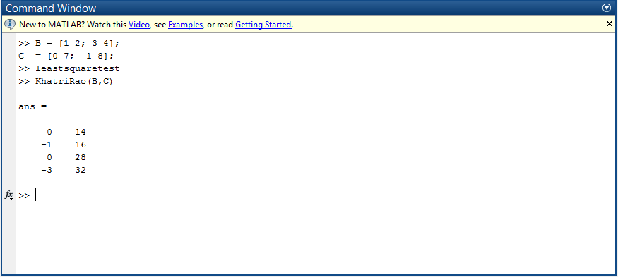
Khatri-Rao Product Simulation
Figure 4: Implemented Khatri-Rao.

Slide 10
Khatri-Rao Product
In matlab...

Slide 11
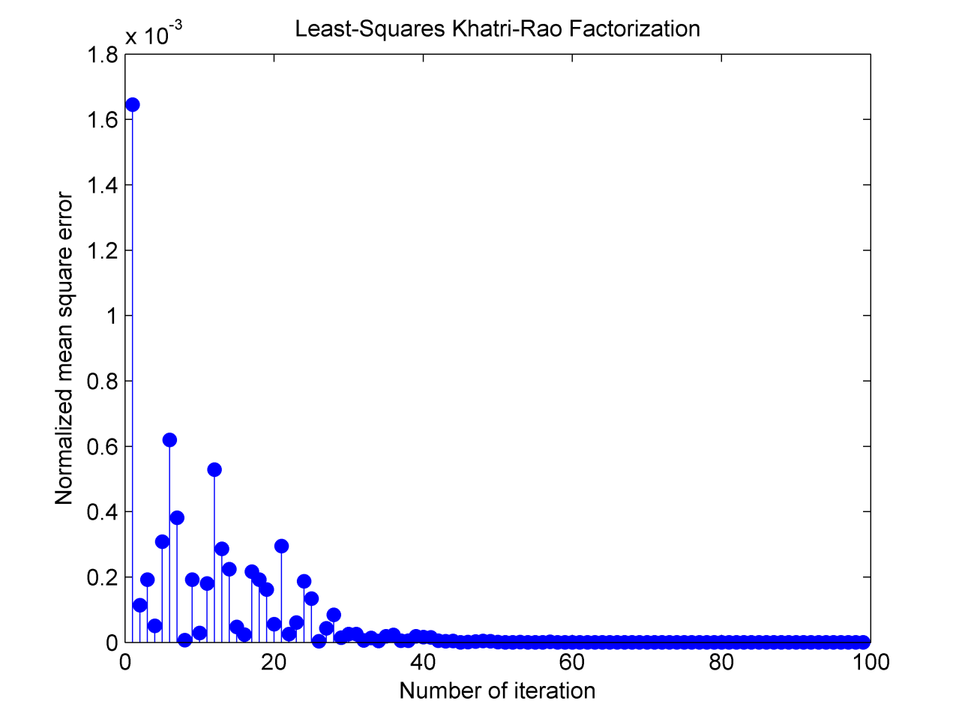
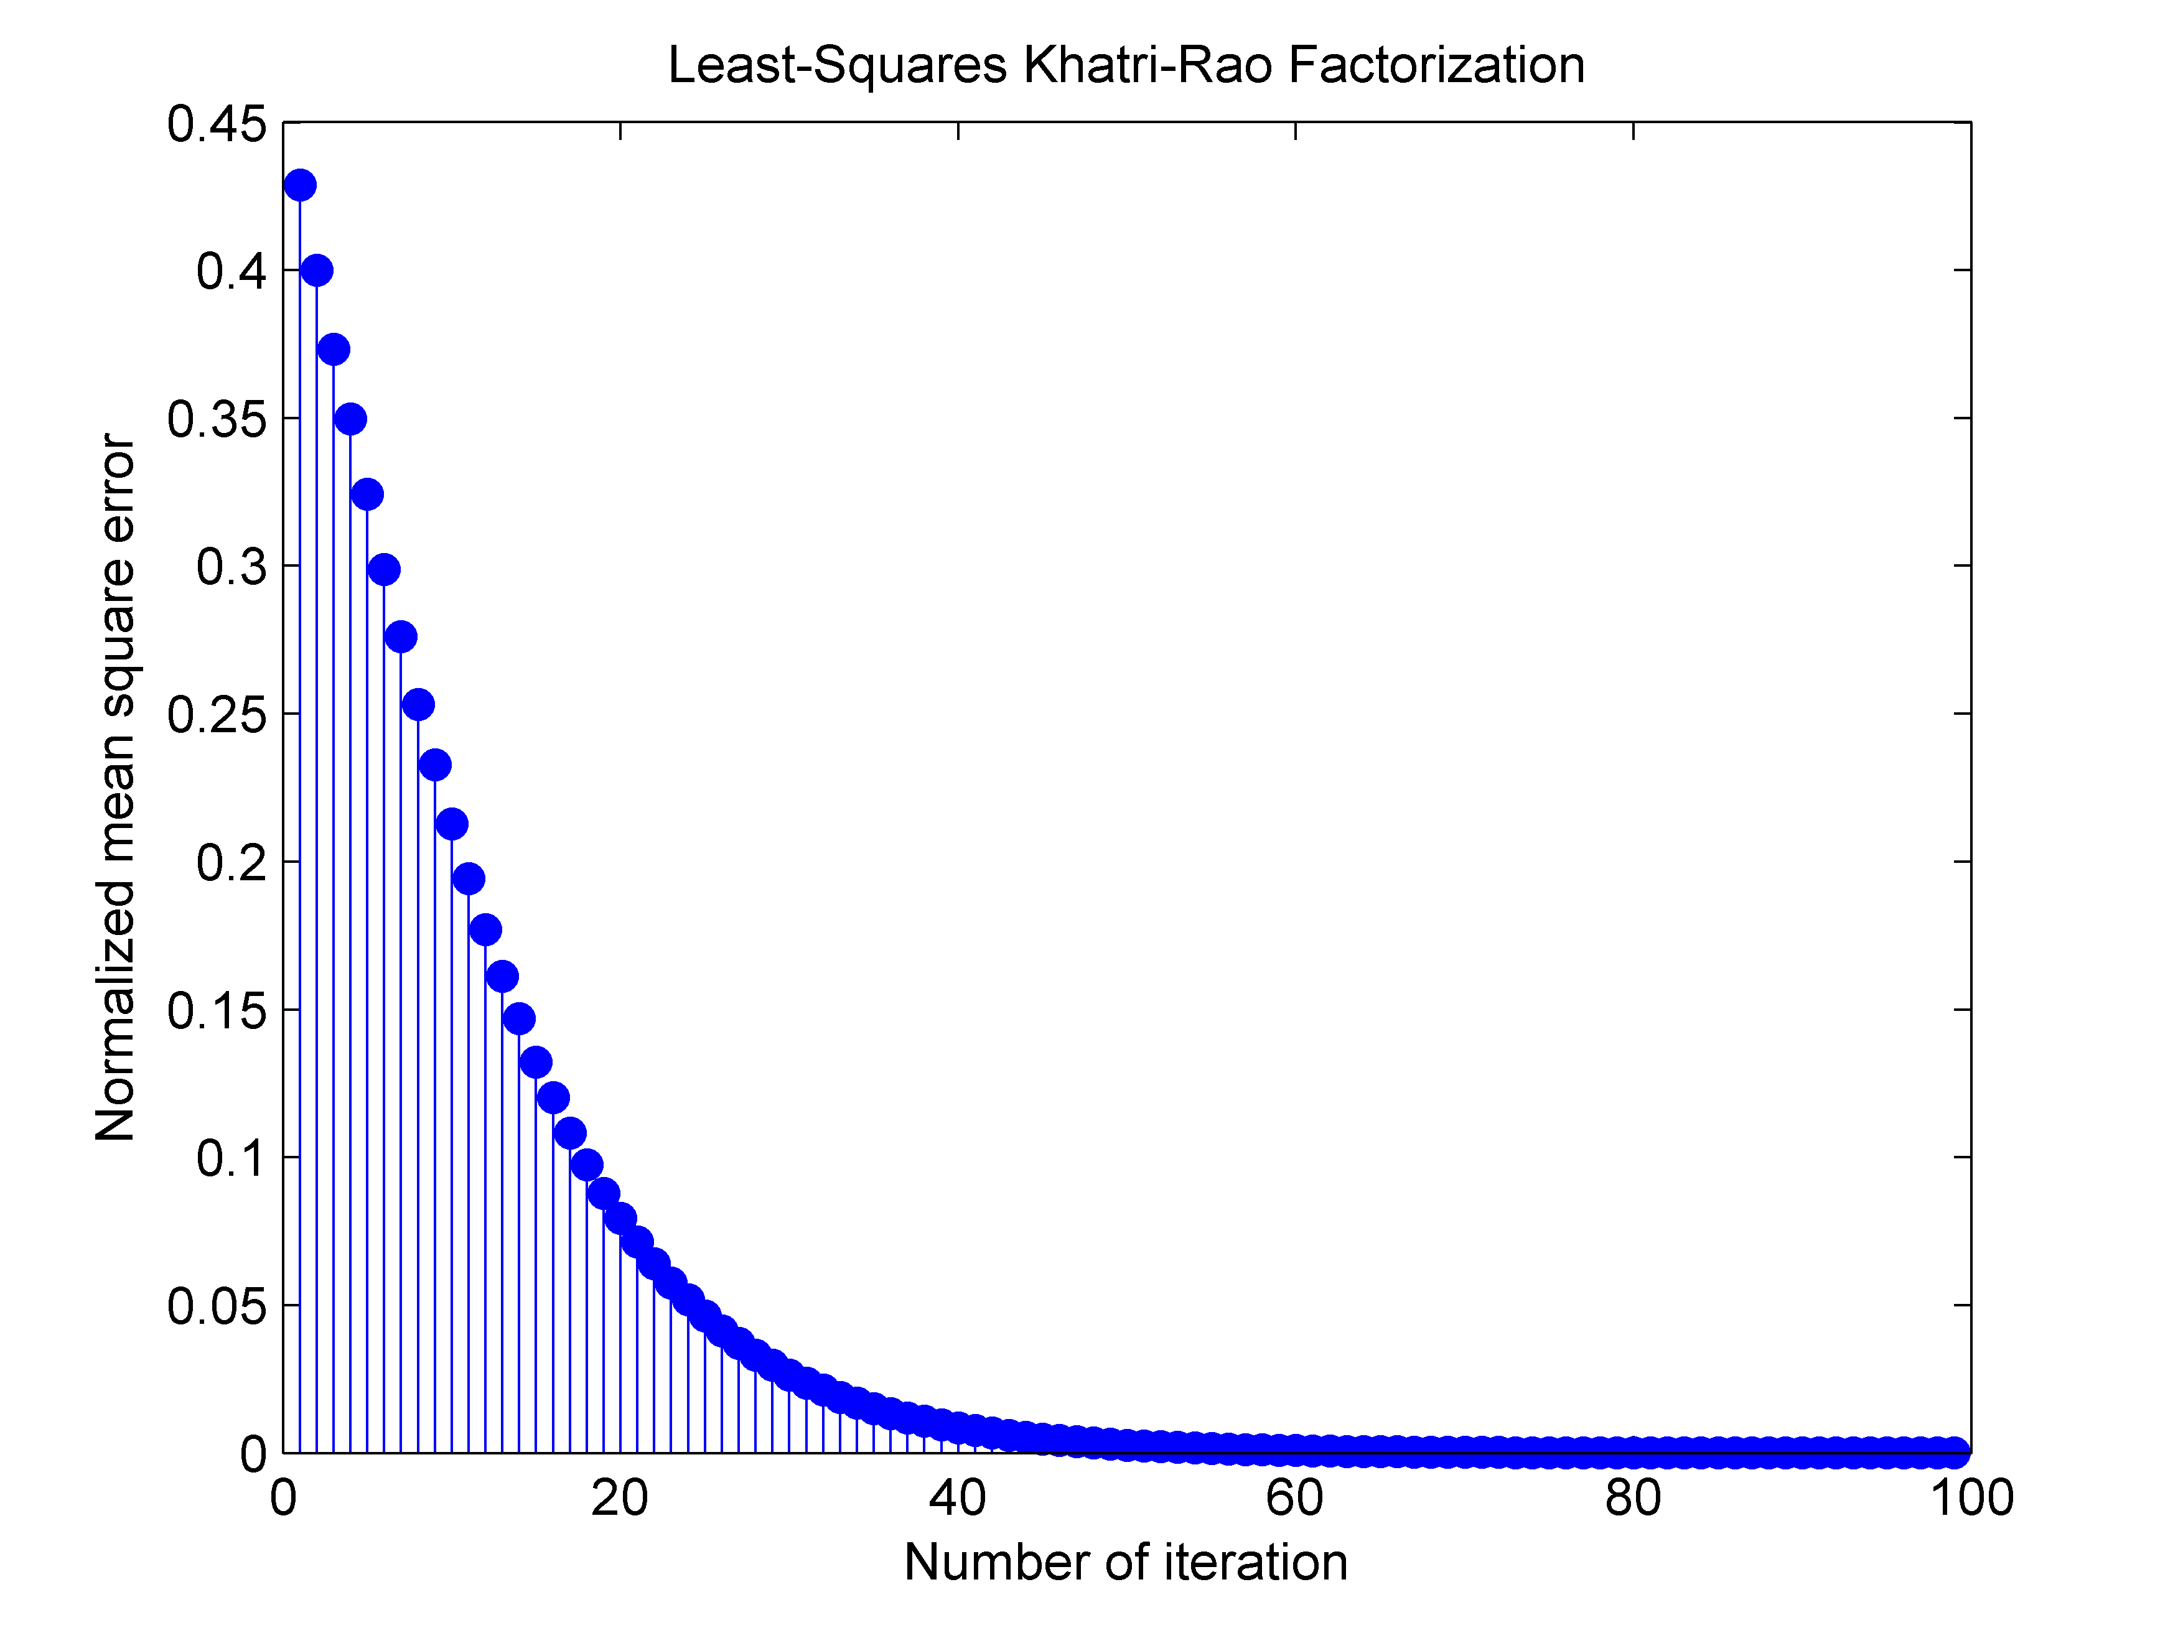
Least-Squares Khatri-Rao Factorization Simulation
Figure 5: Least–Squares for the first example.
Figure 6: Least–Squares for the Hadamard matrices.

Slide 12
Least-Squares Khatri-Rao Factorization Algorithm
In Matlab...

Slide 13

Conclusion
The error increases with the size of the matrix as we can see in the Figures 2, 3 , 5 and 6.
To calculate the Kronecker factorization between two $256×256$ matrices is necessary calculate a SVD for a $65536×65536$ each is computational heavy. On the other hand, for the Khatri-Rao factorization is necessary $256$ SVDs for matrices with dimension $256×256$.

